Slide 1

Name: Panchal Shefali Enrollment no: 160410116070 Class :- SY IT/1 Topic: Economic problem-Inflation
1
1

Slide 2
Contents : A glimpse of what is to come
2
Meaning and Definitions
Types of Inflation
Theories and causes of Inflation
Effects of Inflation
Control Measures

Slide 3
What is Inflation?
Definitions :
“Inflation is an increase in the quantity of purchasing power.”– Gregory
Inflation is the stage of too much money chasing too few goods.”-- Coulbourn
Meaning :
Inflation is considered a global phenomenon. It takes place because of rapidly rising prices of goods and services, resulting in the decline of the value of money.
The rate at which the general level of prices for goods and services is rising, and, subsequently, purchasing power is falling.
3

Slide 4
Types of Inflation
4
Creeping Inflation
Walking Inflation
Running Inflation
Hyper Inflation

Slide 5
Theories and Causes of Inflation
5
The main cause of inflation is the increase in the demand of goods and services and at the same time decrease in the supply of goods and services.
There are two theories related to the causes of inflation:
Demand-pull (when there is excess demand), and
Cost-push (when costs rise)

Slide 6
Theories and Causes of Inflation
6
Demand Pull Inflation – This occurs when aggregate demand is rising while the available supply is less. Businesses respond to high demand by raising prices to increase their profit margin

Slide 7
Theories and Causes of Inflation
7
Cost – push Inflation : This occurs when costs of production or operation are increasing.
Cost Push inflation is mainly caused due to the following factors:
· increase in wages.
· increase in cost of raw materials
· increased cost of imported components (import-push inflation)

Slide 8
Causes
8
Increase in demand
Increase in public expenditure.
Increase in private expenditure.
Increase in consumer spending.
Reduction in taxation.
Repayment of past internal debts.
Increase in population.
Increase in export.
Defict Financing.

Slide 9
Causes
9
Shortage of supply.
Industrial disputes.
Shortage of supply.
Natural calamities.
Hoarding the goods(artificial scarcities).

Slide 10

Control Measures
10

Slide 11
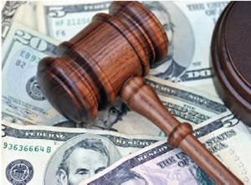
1) Monetry measures
11
Credit control
Demonetisation of currency
Issue of New currency

Slide 12
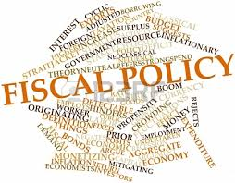
2) Fisical Measures
12
Reduction in Unnecessary Expenditure
Increase in taxes
Increase in savings
Extension of repayment of public department

Slide 13
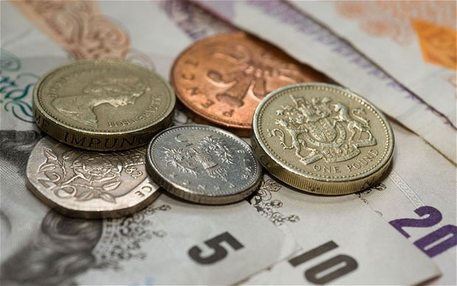
3) Other (direct) Measures
13
Price control
Rationing
Rise in production

Slide 14
Effects of Inflation
14
Effect depends on the speed of inflation and the nature of the economy.
Rising prices of imports
Lowers national saving
Redistribution of Income & Wealth
Collapse of Monetary system
Adverse impact socially and politically
Discourages Investment & savings
Higher Interest / Income tax rates

Slide 15

15

